Slide 1

ETF/STOCK Time Series FORECASTING

Slide 2

Our Objective
The objective of our project is neither to build
a system that makes billions nor to waste billions
But the objective is to develop a system that finds
the direction of change of ETF/STOCK prices based
on the co-relations between STOCK prices and help
the investors in the stock market in taking
a decision whether to buy/sell/hold a ETF or stock by
providing the results in-terms of visualizations

Slide 3
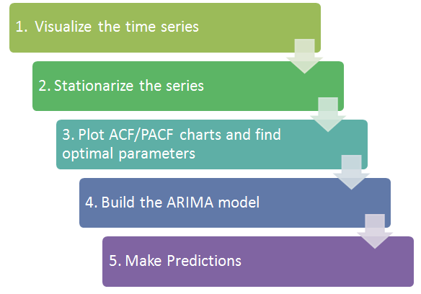
The Process
Time series

Slide 4
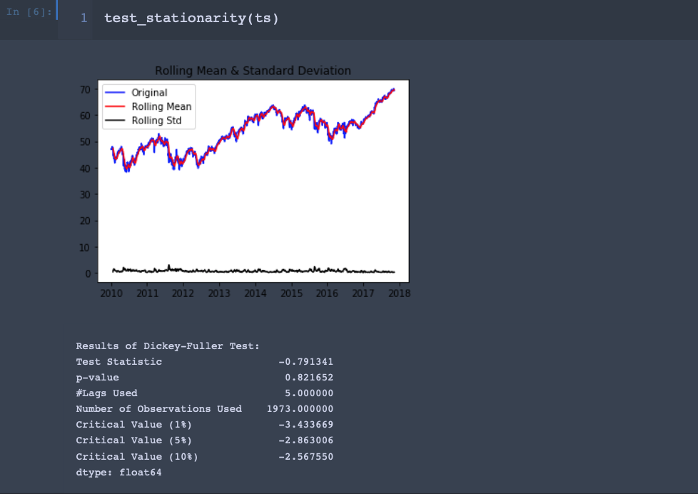
Checking For Stationarity
Results – Not so good
Notes:
Stationary Time Series: data does not have any upward or downward trend or seasonal effects. Mean or variance are consistent over time

Slide 5
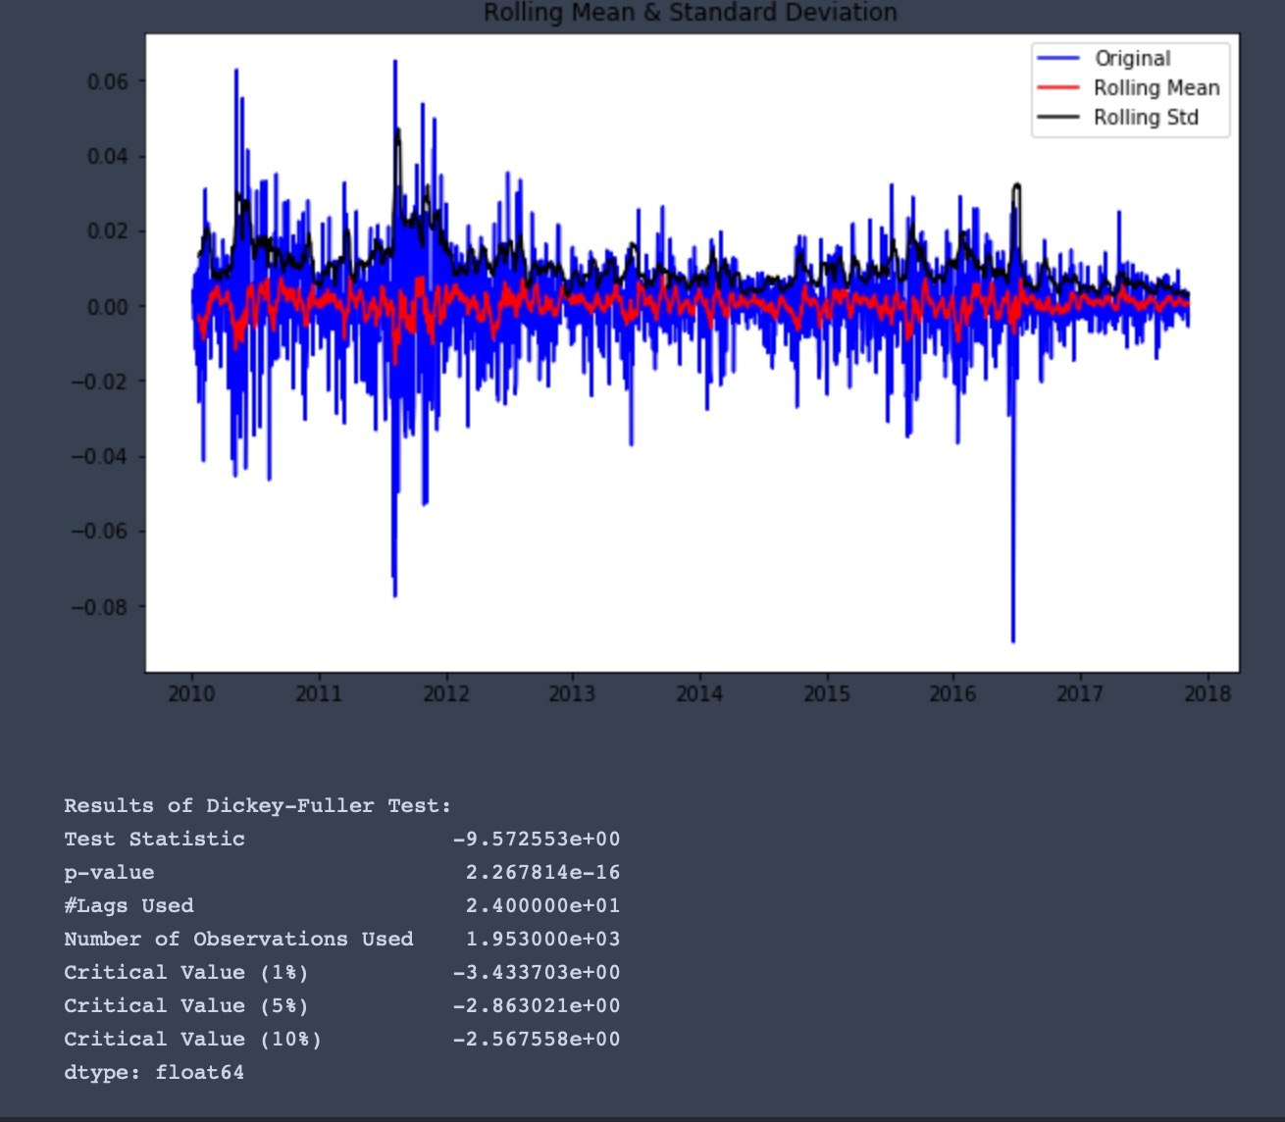
Eliminating trend and seasonality
Results of Dickey-Fuller Test:

Slide 6
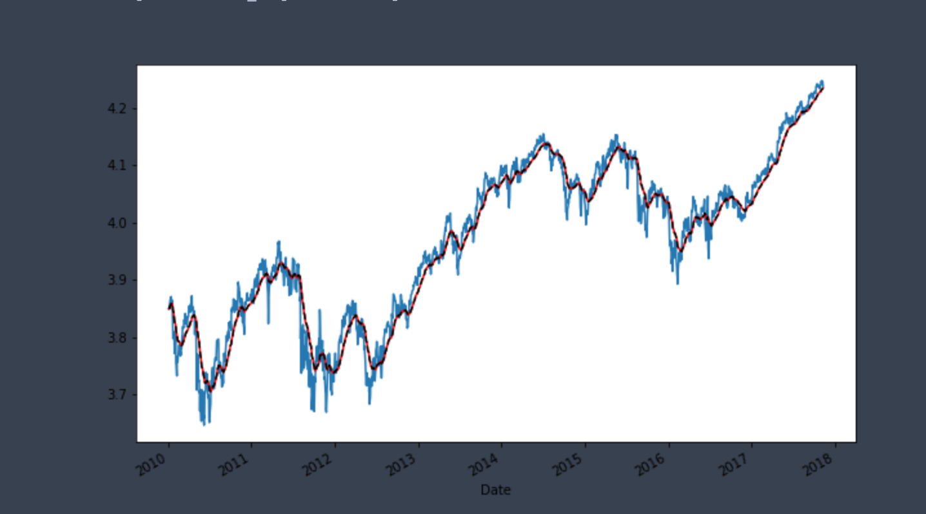
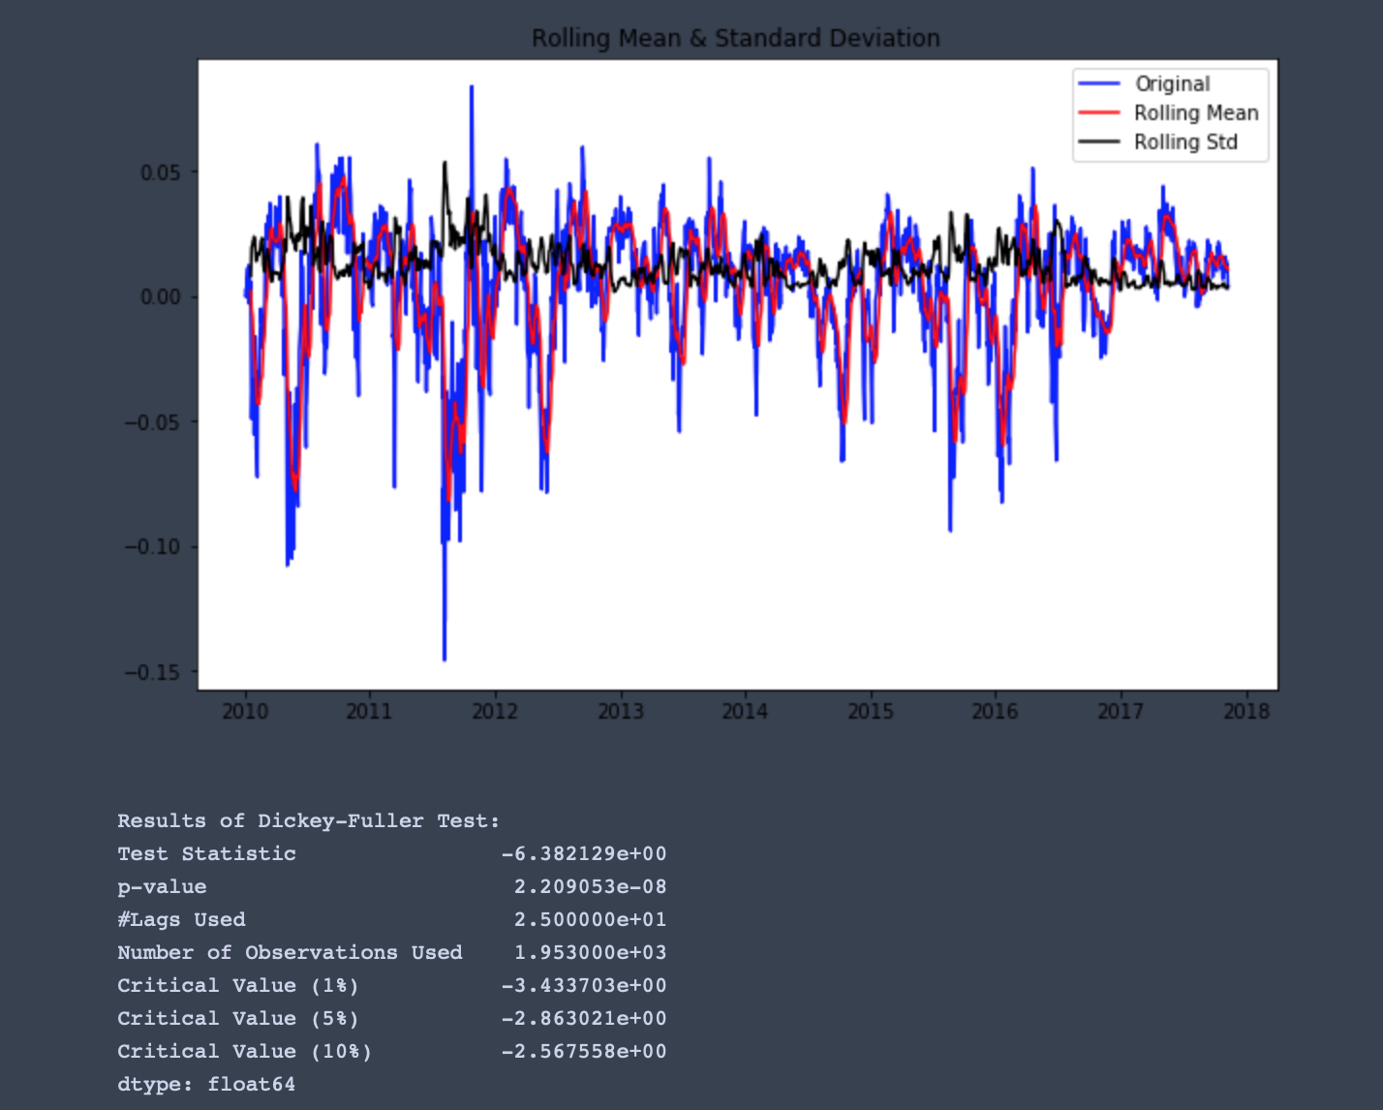
Exponential Moving Average
Results of Dickey-Fuller Test:

Slide 7
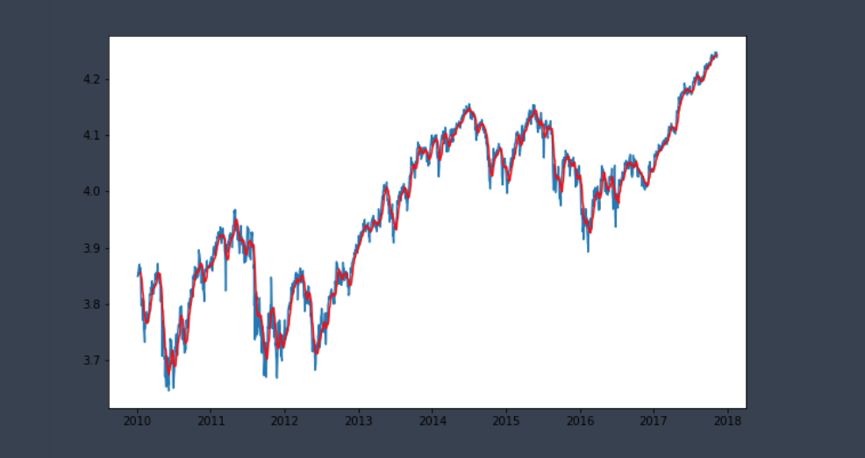
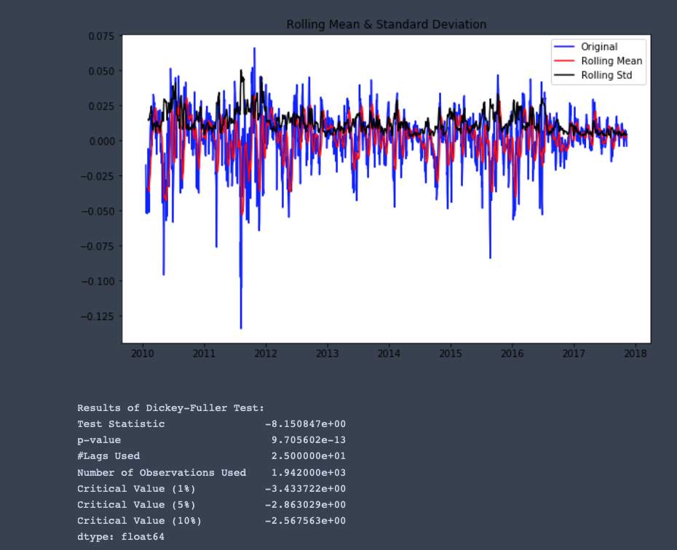
Log Moving Average Diff
Results of Dickey-Fuller Test:

Slide 8
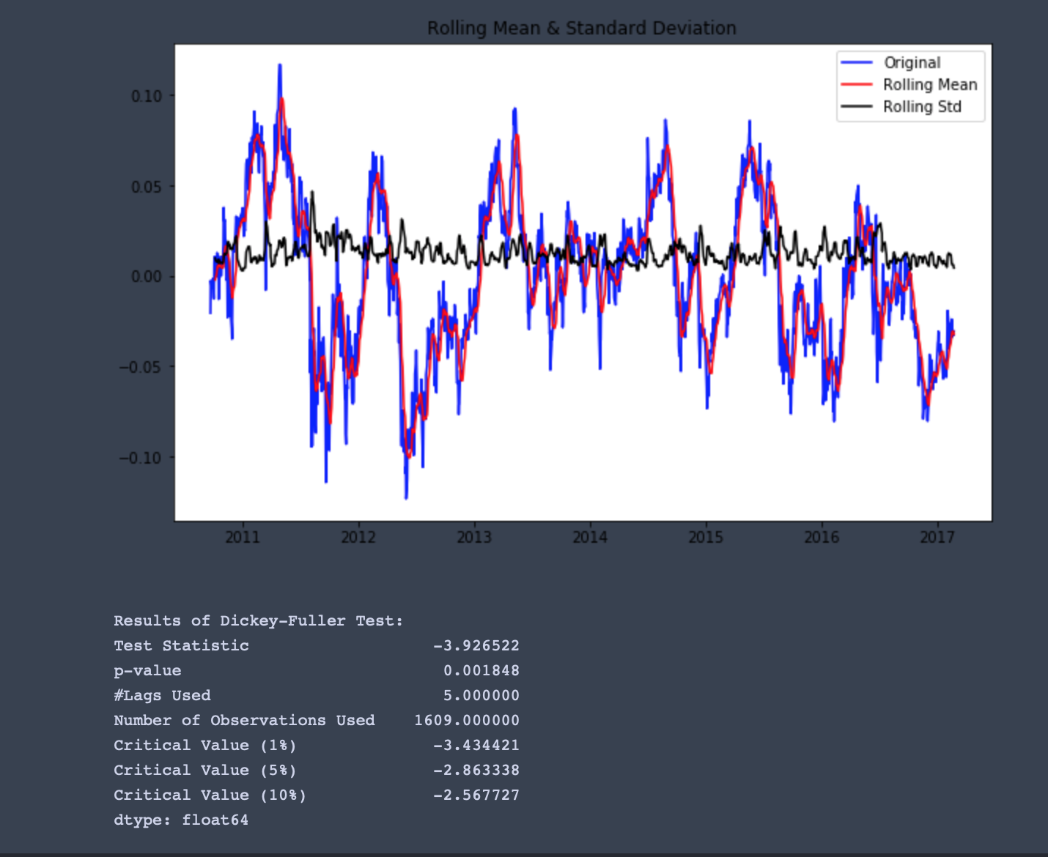
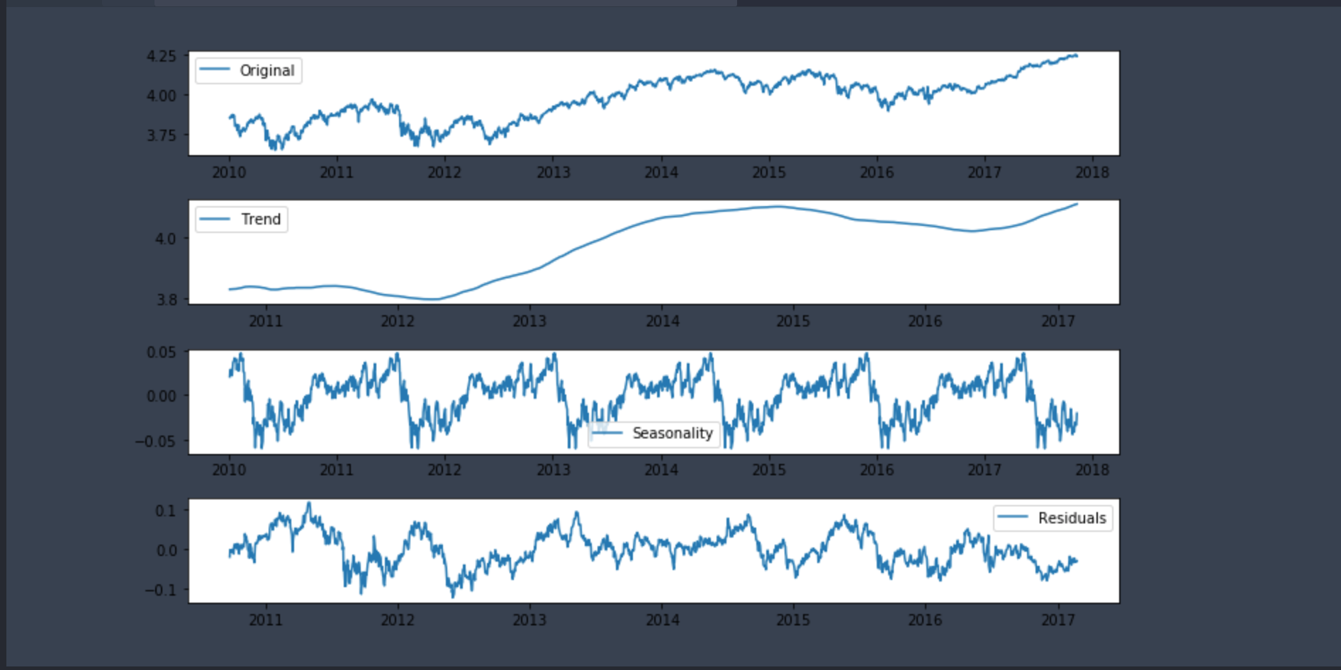
Decomposition
Results of Dickey-Fuller Test:
Notes:
Extracting Seasonality and Trend from Data

Slide 9
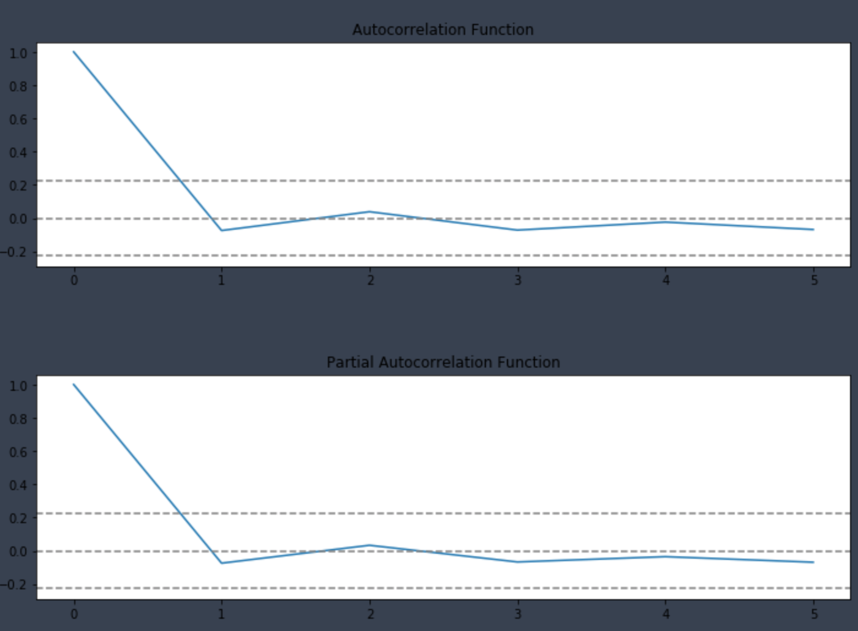
ACF & PACF
plots
Notes:
In decing the lag lenght for AR or ARMA Models which one should be considered.

Slide 10
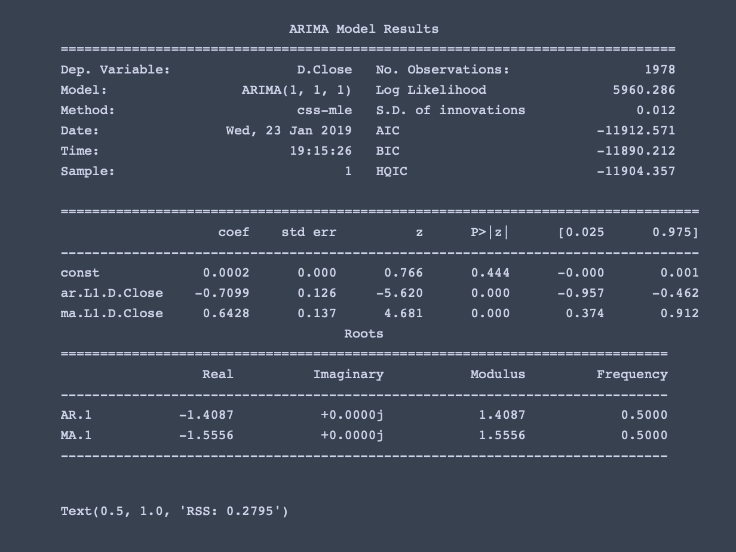
Arima Model

Slide 11
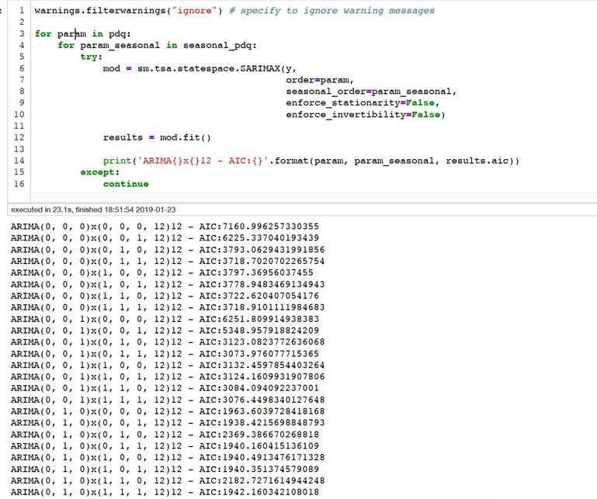
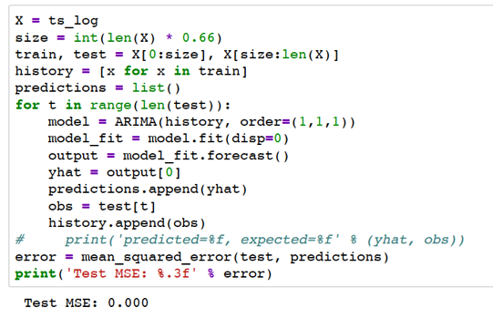
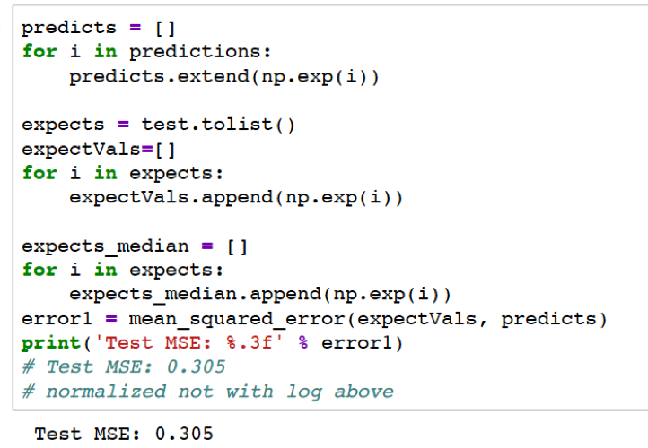
Model Error
Resampled Data

Slide 12
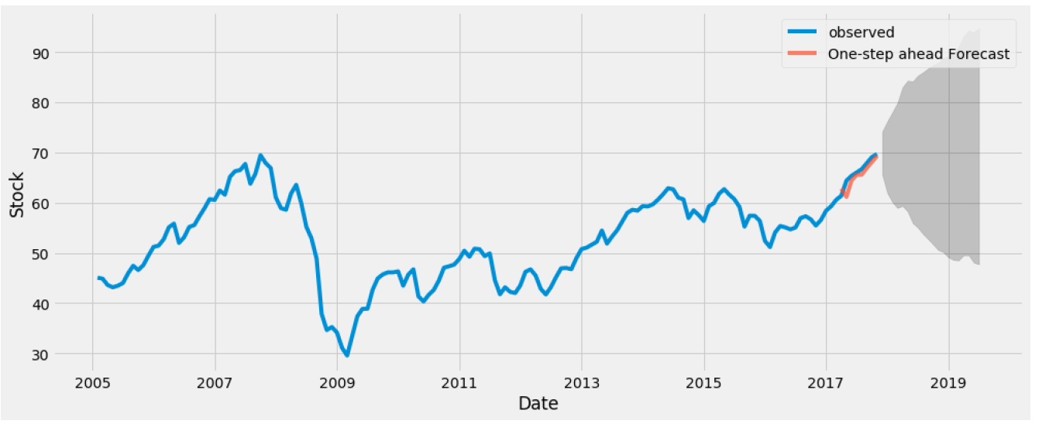
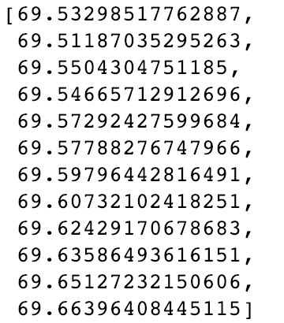
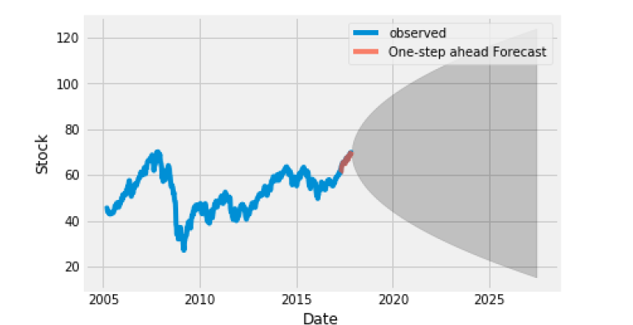
Forecast EFA closing Price
Monthly Resample
Weekly Resample

Slide 13
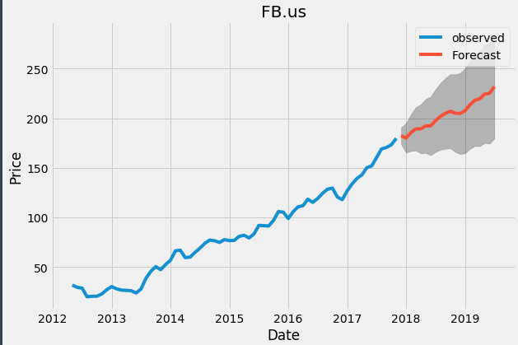
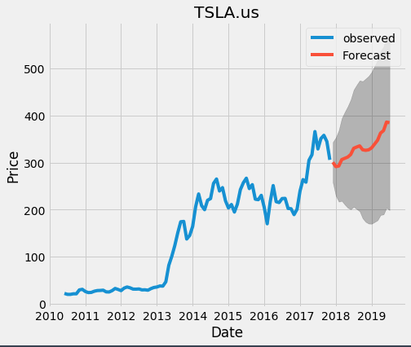
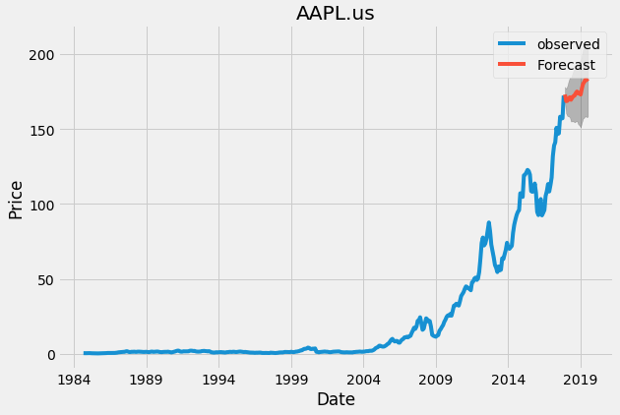
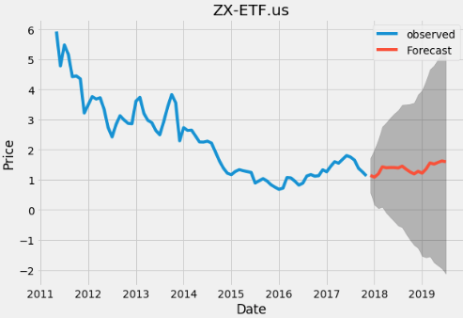
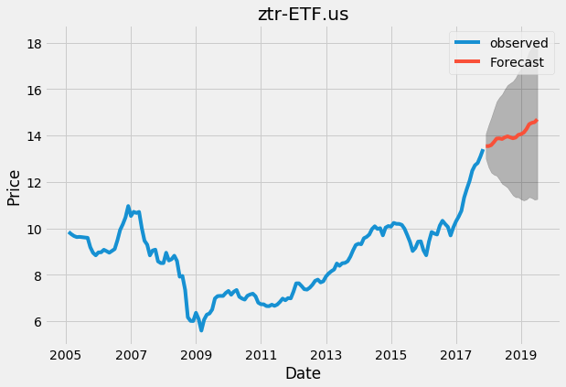
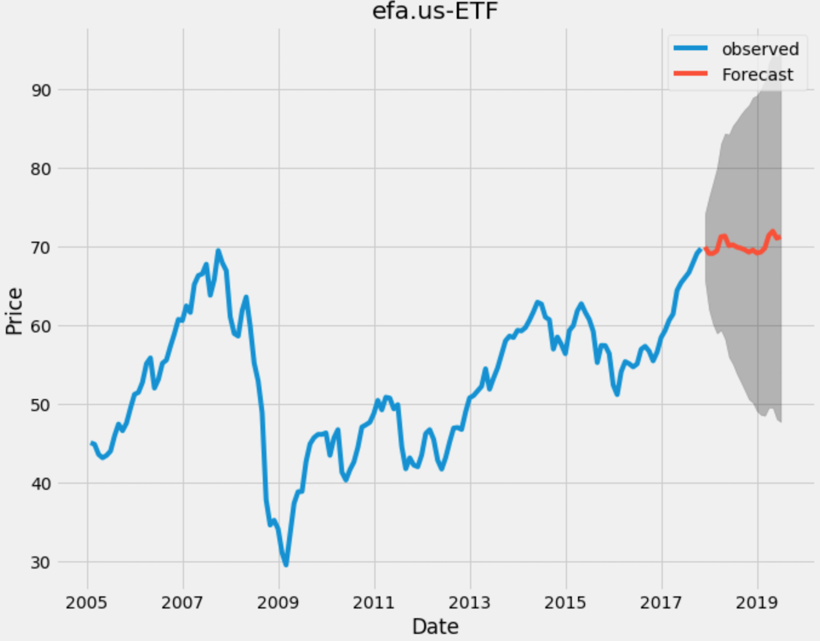
Some Predictions
Using resampled weekly Data forecast model
Showing Upper and Lower confidence levels

Slide 14
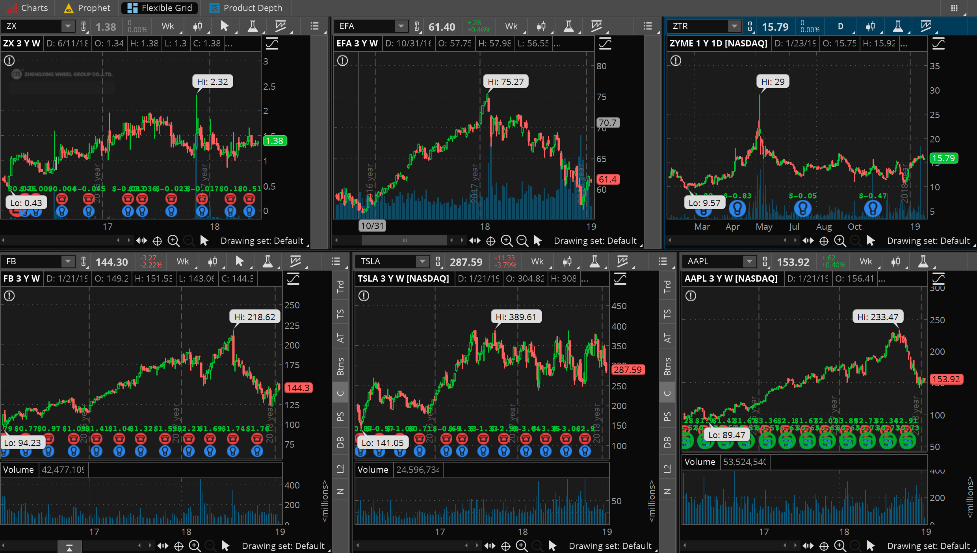
Actual Price Comparison

Slide 15

Future Improvements
Add more data from other sources
Event driven analysis
Extra visualization for close price
Recurrent neural network with LSTM
Add more variables to predict the adjusted close price

Slide 16
Thank you
Kyle Powers
Marcello Urquieta

